Slide 1
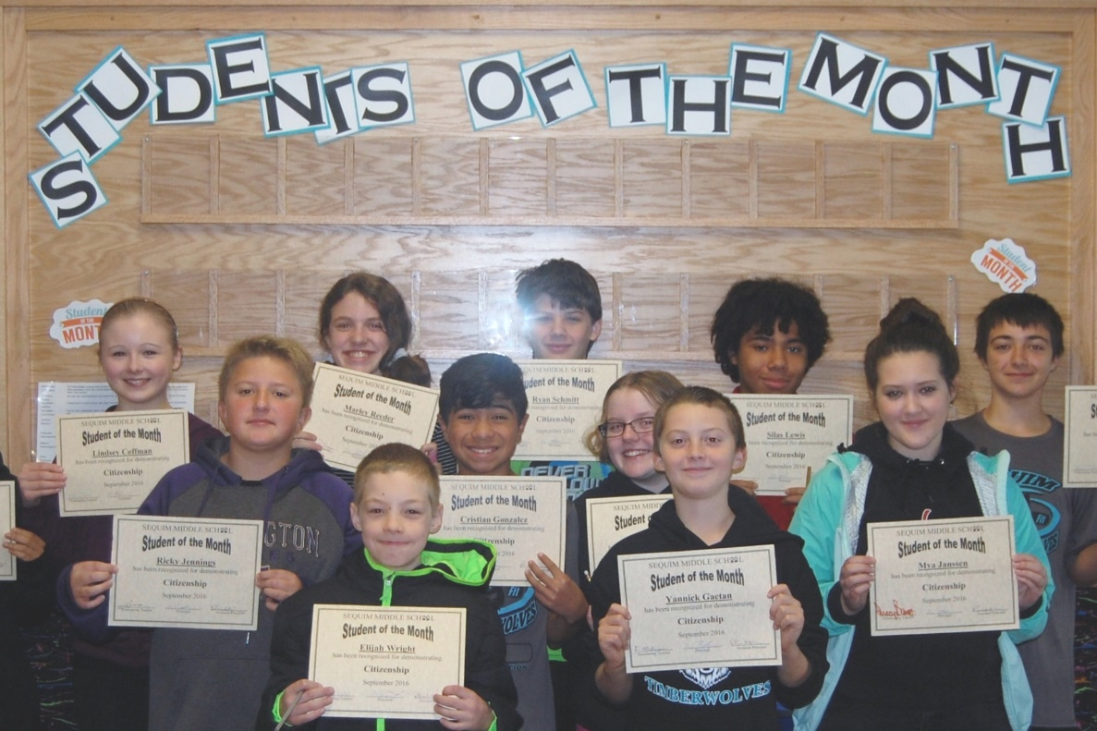
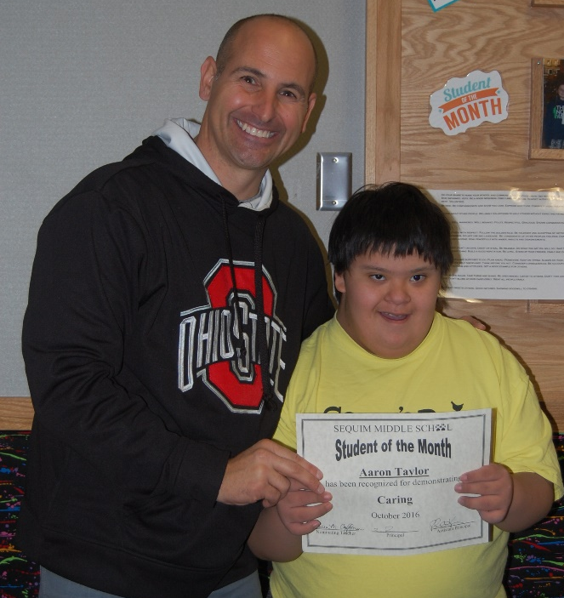
“All Children are Capable of Success, No Exceptions!
SMS
School Improvement Plan
2016-2017

Slide 2
SMS – Demographics
623 students
182 - 6th graders
226 - 7th graders
215 - 8th graders
43% - Free & Reduced lunch
9% - Hispanic/Latino
1.9% - American Indian / Alaskan Native
2.4% - Asian
.3 – African America
.2 - Native America
6.6% - Two or more race
79.5 - White

Slide 3
Student Learning – SBA data
English Language Arts
Math
Science
SMS – 2015 | SMS – 2016 | w/Basic | Gr | State – 2015 | State – 2016
53 | 57 | 59.6 | 6th | 54 | 56
57 | 61 | 63.5 | 7th | 58 | 57.9
68 | 66 | 69.7 | 8th | 58 | 59
SMS – 2015 | SMS – 2016 | w/Basic | Gr | State – 2015 | State – 2016
45 | 47 | 48.8 | 6th | 46 | 47.8
52 | 51 | 52.8 | 7th | 50 | 49.5
56 | 44 | 44.6 | 8th | 47 | 47.6
SMS – 2015 | SMS – 2016 | w/Basic | Gr | State – 2015 | State – 2016
73 | 77 | 78.9 | 8th | 61 | 69

Slide 4
A closer look at SBA data…
Closing the opportunity gap
Low Income & Non Low Income
7th grade Math
40% vs 63%
Special Services & Non SS students
8th grade ELA
12.5% vs 74.5%
Focus Status

Slide 5
Efforts to Improve
Differentiated Instruction ​& Collaborative Planning ​
Align Student Growth Goals with special services students​
(6 – 12) Professional Development ​
Implementing PBIS
​
​Special Services review ​
model needs to change ​
curricular challenges​
lack ELA materials (all students) ​
Eureka & other materials

Slide 6
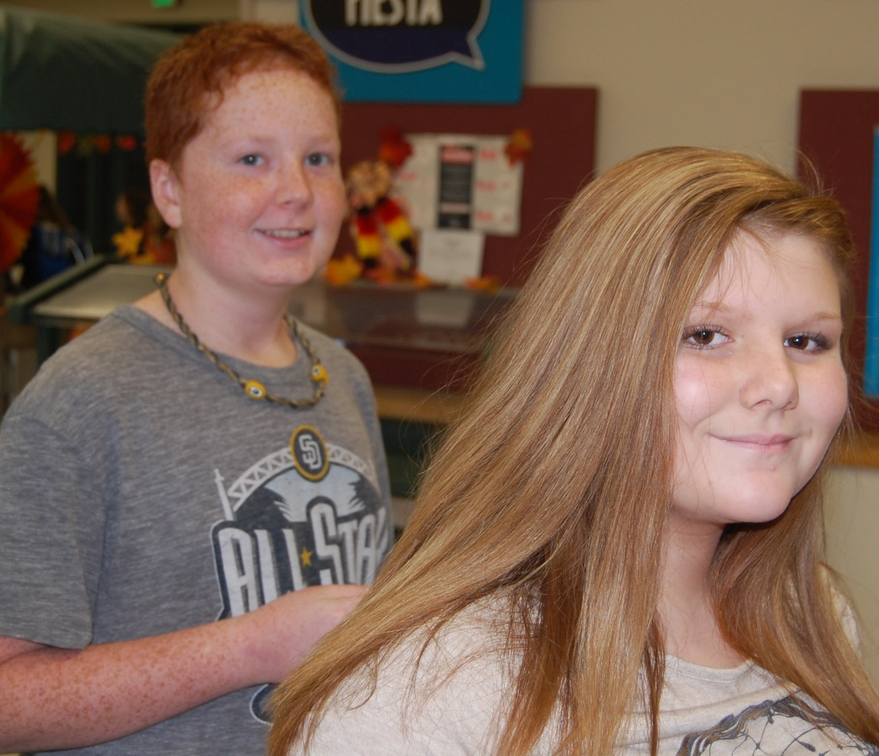
Current Efforts
Book Study: “Why Kids Don’t Like School”​
Implementation: I-ready data system during collaboration time
Implementation: F’s remedy process
PBIS & SMS ROCKS
Create Growth & Improvement Night
(Family Involvement)
Pilot – ELA materials
Kids at Hope

Slide 7
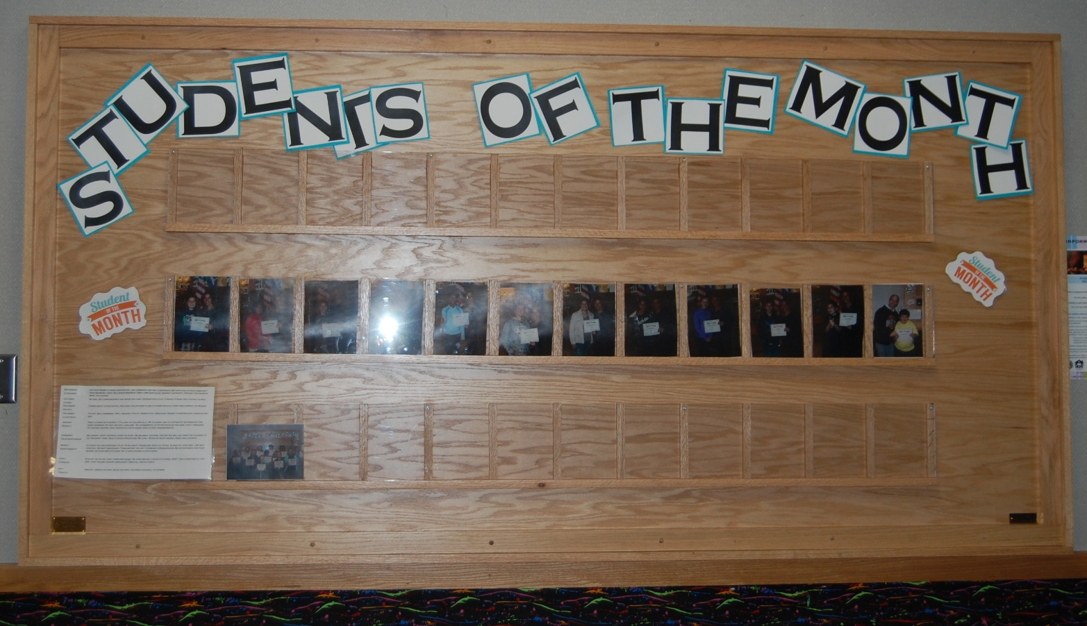
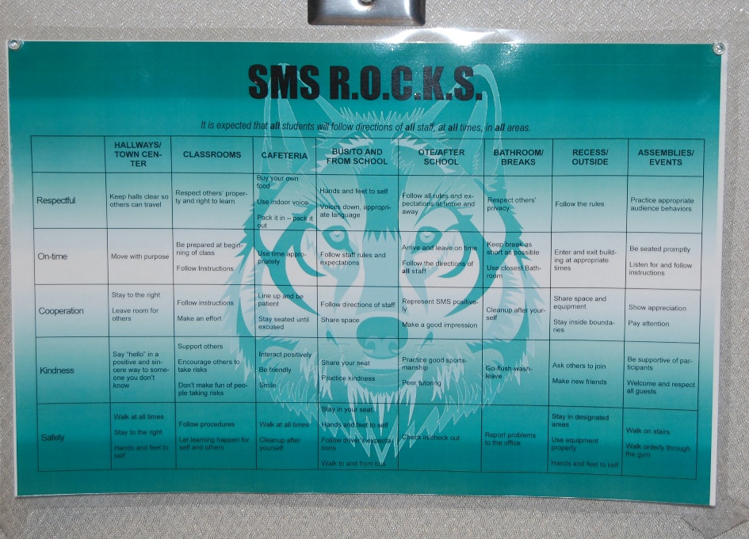
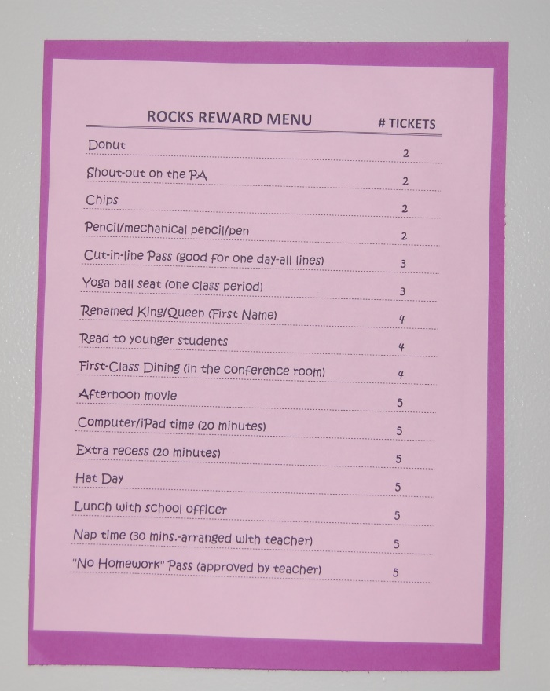

Slide 8
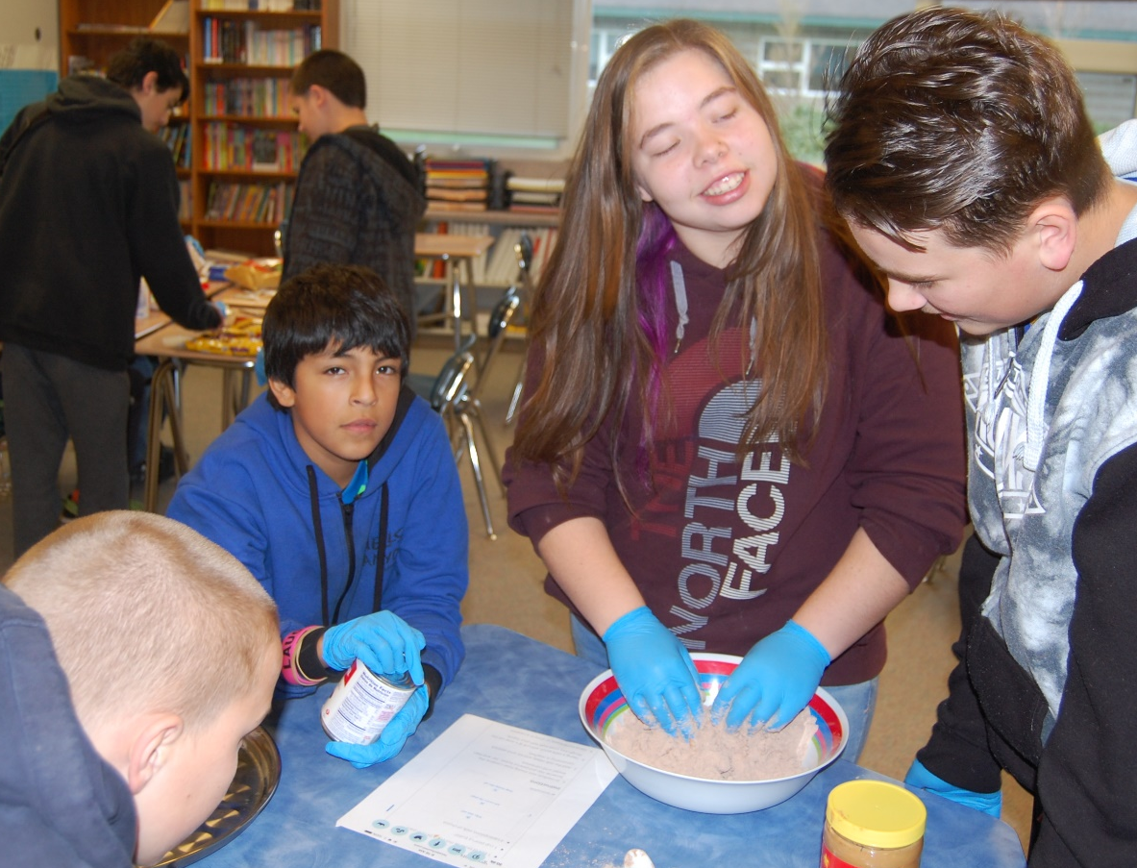
Hope Academy

Slide 9
Cultural Success @ SMS
Kids at Hope ​
Hope Academy ​
Referral data
635 referrals (14-15)
321 referrals (15-16)
6 referrals currently
​Student Perceptual CEE data
88% clearly understand the behavior rules
- 79% previous year
57% of our students believe their teacher(s) help them learn by challenging them with interesting activities
- 43% previous year
Culture of All Kids
Web Day & Harvest Fest

Slide 10
Sequim Middle School
Thank you!

